Slide 1
Project Proposal
Data Statistics SS 2022
Supervisor: Dr. Dinkelacker
Tutor: Ian Dirk Fichtner
TRAs expression in Human Embryo Cells
Alina Aksianova, Letizia Holube, Nina Bank, Lydia Steiner

Slide 2
Structure
biological background -literature
questions/hypotheses aim
QC and knowledge of the datasets
project structure, planned analysis and milestones
exploratory data analysis

Slide 3
TRAs
Tissue Restricted Antigenes
Central tolerance of the immune system = Negative Selection process (Kyewski & Klein,2006)
Developing T-Cells -> exposed to TRAs in thymus -> binding cells apoptosis
Defect: Auto immune diseases, e.g. Diabetes Type I (Atkinson, Eisenbarth, Michels, 2014)
Application: Tumor Marker, Immunotherapy (Hong, 2014), (Mahmoud,2018)

Slide 4
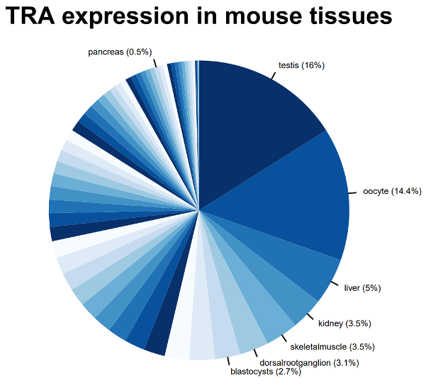
TRA-gene table
ensembl.transcript | ensembl.gene | gene.symbol | entrezID | refseqID | unigeneID | chrom | startsite | tiss.number | tissues | max.tissue
ENSMUST00000000003 | ENSMUSG00000000003 | Pbsn | 54192 |  |  | X | 77837901 | 1 | prostate | prostate
tra.2014.mouse.5x.table
War hier nicht mal was?
Dinkelacker, 2007
Dinkelacker, 2019
Notes:
Datensatz kurz

Slide 5
Dataset
What did we choose, why did we choose it
Irie, N., & Kuratani, S. (2011). Comparative transcriptome analysis reveals vertebrate phylotypic period during organogenesis. Nature communications, 2, 248. https://doi.org/10.1038/ncomms1248
Gene Expression in mouse embryo development
Intervals: E7.5, E8.5, E9.5, E10.5, E12.5, E14.5, E16.5, E18.5 (days after mating)
each containig 2-3 samples with RNA of multiple whole embyos
Notes:
Phylotypic stage: developmental period in mid-embryogenesis where related species within a phylum (Tierstamm), highest resemblance
Datensatz erklären können

Slide 6
Structure of the data
20 Chips in total
E7.5
E7.5
E7.5
E12.5
E12.5
Days after mating
0.5 -> Morning after
E8.5
E8.5
E8.5
E14.5
E14.5
E9.5
E9.5
E9.5
E16.5
E16.5
E10.5
E10.5
E10.5

Slide 7
QC - Single Chip Control

Slide 8
QC - Normalization
Via vsnrma: Variance stabilization and calibration for microarray data

Slide 9
QC – RNA Dagradation

Slide 10
QC – Scatter Plot
1 | 2
2 | 3
3 | 4
4 | 5
5 | 6
6 | 7
7 | 8
... | ...

Slide 11
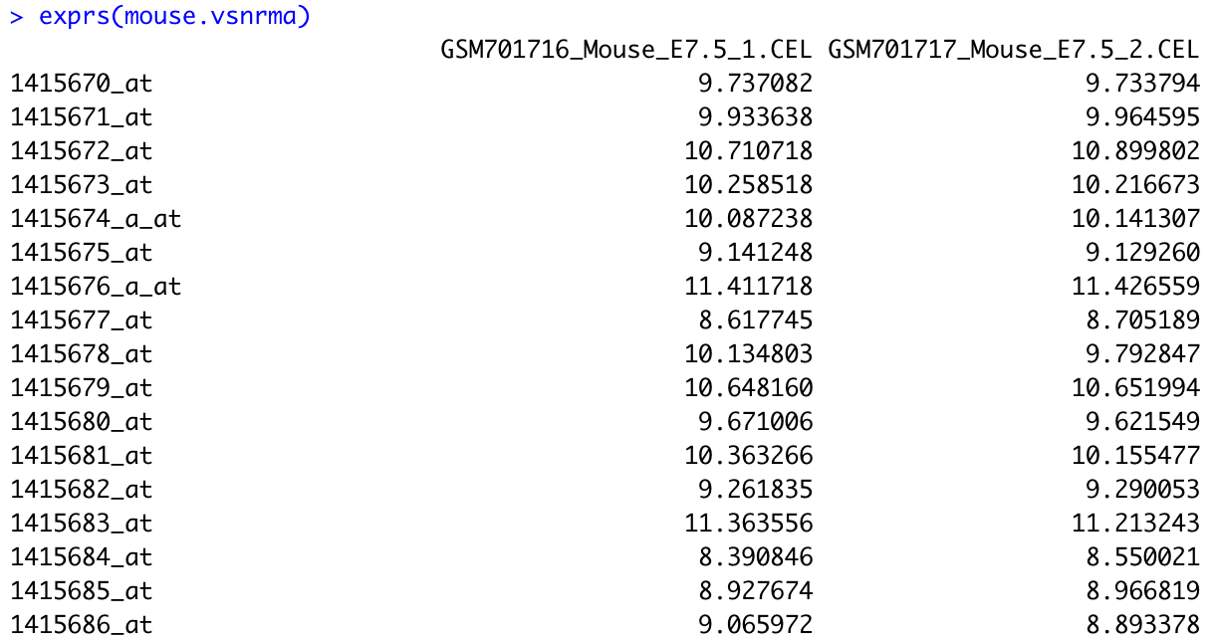

Slide 12
Chemokines
Notes:
Datensatz kurz

Slide 13
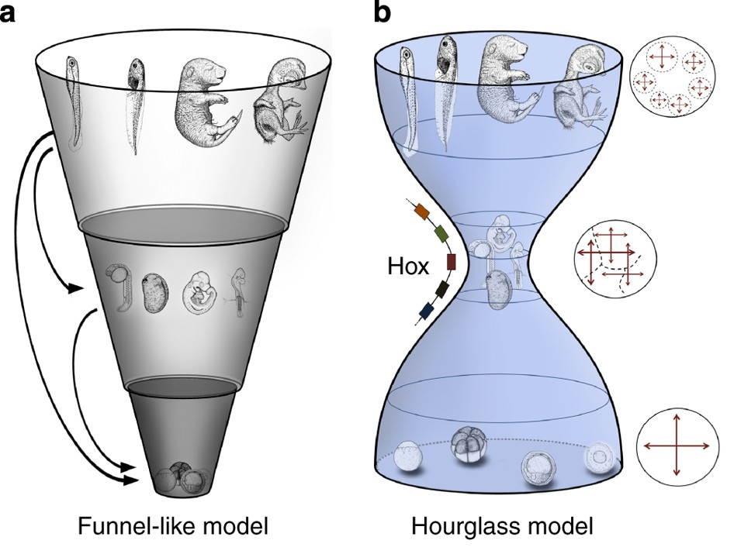
Paper vorstellen/Biologischer Background
Comparison of the transcriptome during phylotypic period of multiple vertebrates
Two theories for development
Funnel-like model: increasing diversity over time
Hourglass model: mid-embryonic stages (organogenesis) are more evolutionarily conserved
Irie, N., Kuratani, S. Comparative transcriptome analysis reveals vertebrate phylotypic period during organogenesis. Nat Commun 2, 248 (2011). https://doi.org/10.1038/ncomms1248

Slide 14
Verknüpfung von Datenset und Biologie
Was sagt der Datensatz? Welche Zeilen? Was bedeuten die Zahlen etc?

Slide 15
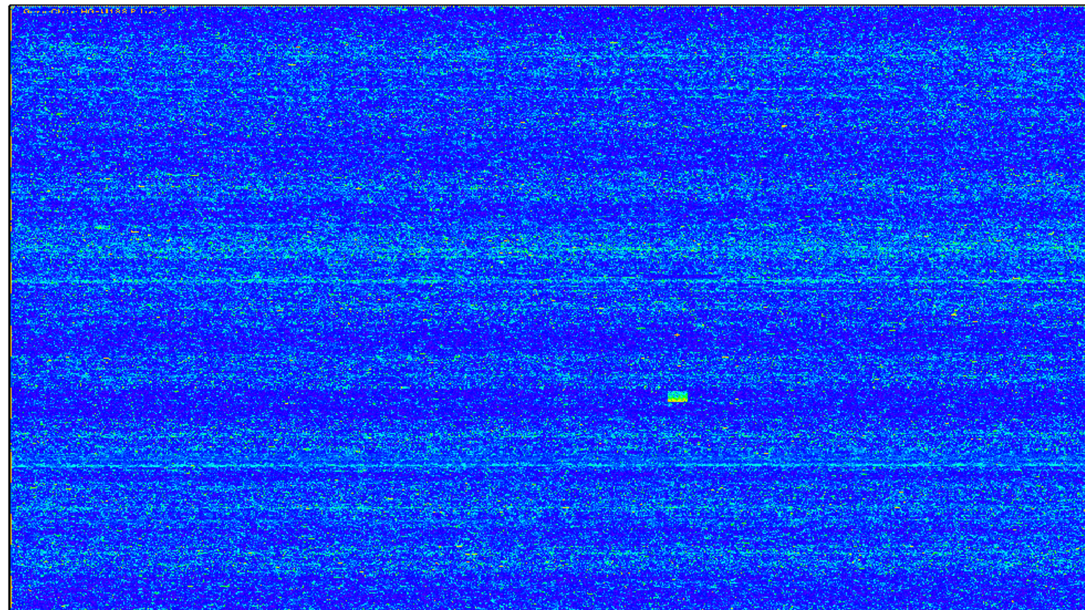
Microarrays
Gene Chip that reads gene expression in form of RNA
RNA -> cDNA -> labelling -> Hybridisation -> Scanning -> Data Acquisition
Labelling via biotin or Fluorescence
Brand of chip: Affymetrix Mouse Genome 430 2.0 Array
Internal Quality Control

Slide 16
Early organ development in mouse embryo

Slide 17
Methods
RNA degradation plot for quality control
VSNrma Normalisation
Boxplot before and after normalisation
If necessary Quantile normalisation
Scatter plot to control chip quality

Slide 18
Clean Data: Correctly assign gene names to Microarray dataset
New table with genes of low variance removed

Slide 19
Chipwise Quality Control
Maybe, we can try this out for a few chips and include some examples
Single cell control

Slide 20
“Hypothese”
How does the differential expression levels change over time of organogenesis in mice?
How does this data correlates with the known TRA-data?
Can we analyse Datensatz in Hinsicht auf den Chemokines
Whether there is a correlation with Chemokines or TRA?
E.g. how to combine with Chemokines, TRA?

Slide 21
Exploratory Dataanalysis
Histogramme
Density plots

Slide 22
What have we done until now?
Week 1
Week 2
Week 3
19.05. 2022
Data Camp
Github
Organization
Quality Control
Data Exploration
Project Proposal Presentation
Notes:
Erste Folie: was wir bisher gemacht haben
Zweite folie: was noch kommt und dann spezifischer
Sauber Einteilen!!!!

Slide 23
Spezifizierte milestones
Data Exploration: xy
Bioanatytics:
PCA, heatmaps
k-means
differential gene expression
Compare to literature

Slide 24
Timeline
Week 1
Week 2-3
Week 4-6
Week 7-8
13.07. 2022
Further Data Exploration
Biostatistic analyses
TRA and chemokine analyses
Compare to literature
Bug Fixes
Finish presentation and report
Final Presentation

Slide 25
Biostatistic analyses/ Bioanalytics
PCA, heatmaps
k-means
differential gene expression
Compare to literature

Slide 26
Schöne Schlussfolie?
Oder Timeline als letztes, könnte auch nice aussehen

Slide 27
Literature
Dinkelacker 2019. Chromosomal clustering of tissue restricted antigens, Dissertation, University Heidelberg, Germany.
Dinkelacker 2007. A database of genes that are expressed in a tissue-restricted manner to analyse promiscous gene expression in medullary thymic epithelial cells. Diplomarbeit, Albert-Ludwigs-Universitaet, Freiburg, Germany.
Irie, N., Kuratani, S. Comparative transcriptome analysis reveals vertebrate phylotypic period during organogenesis. Nat Commun 2, 248 (2011). https://doi.org/10.1038/ncomms1248
Kyewski et al. 2004, Self-representation in the thymus: an extended view, Nat. Rev. Immunol. 2004 Sep, 4 (9) 699-698. https://pubmed.ncbi.nlm.nih.gov/15343368/

